Slide 1


Lesson 21 The lights went out
UNIT 5

Slide 2

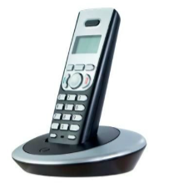
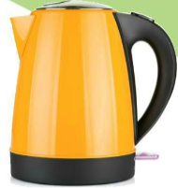

Which electrical appliances do you use on a daily basis? Which ones do your family members use? Why? Discuss in class.
Write down names of these electrical appliances.

Slide 3
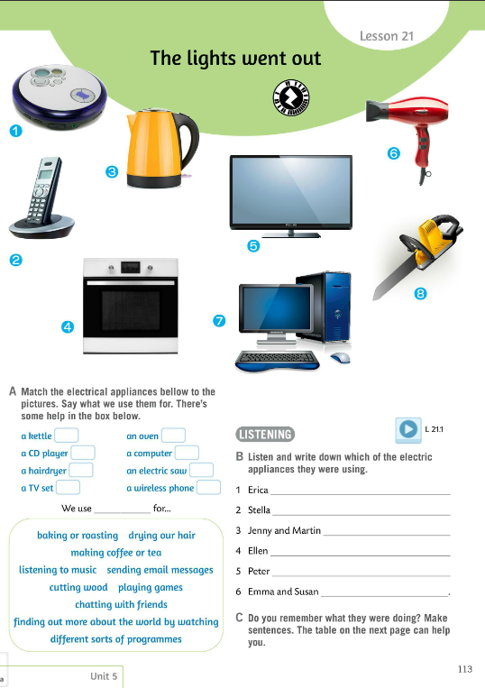
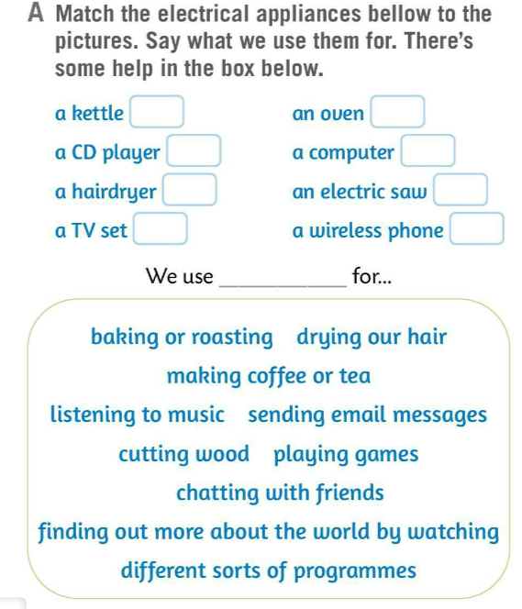
Match the electrical appliances below to the pictures. What do we use them for?
Check.
Write the sentences using the structure:
We use _______ for ...
Example:
We use a kettle for making tea or coffee.
We use a kettle for making coffee or tea.
We use a CD player for listening to music.
We use a hairdryer for drying our hair.
We use a TV set for finding out more about the world by watching different sorts of programmes.
We use an oven for baking or roasting.
We use a computer for sending emails/ chatting/finding information.
We use an electric saw for cutting wood.
We use a wireless phone for chatting with friends.
3
4
1
7
6
8
5
2
Check.

Slide 4

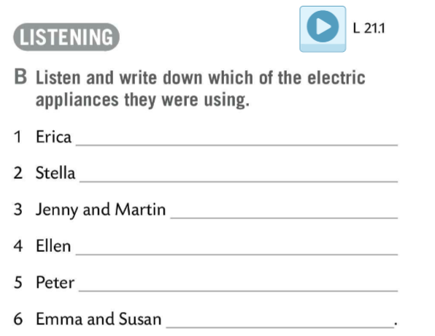
Do Task B. Listen and write down which of the electric appliances they were using.
Check.
an oven/ a kettle
What are the electrical appliances used for?
Play this game and find out! https://wordwall.net/play/511/222/438
a hairdryer
a computer
a wireless phone/ a TV set
an electric saw
a CD player

Slide 5
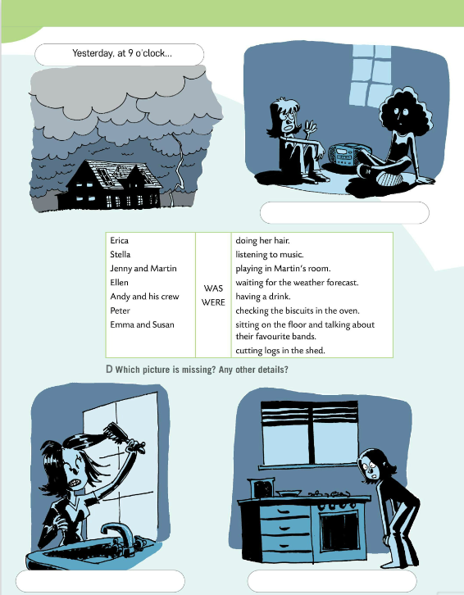
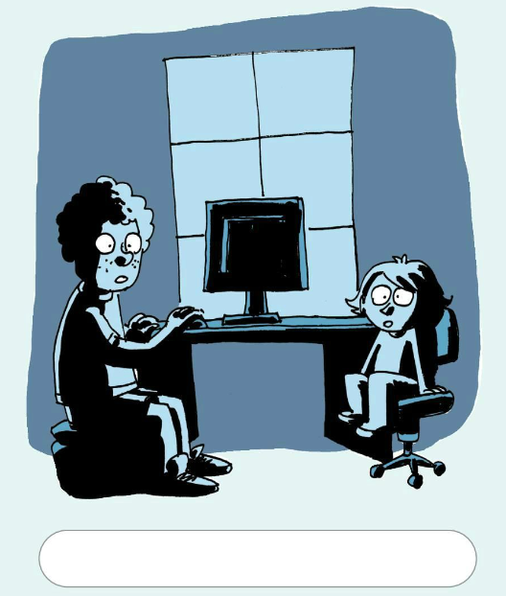
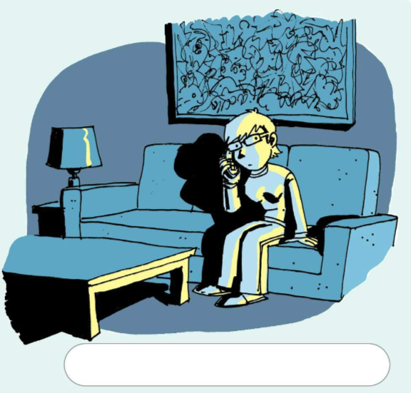
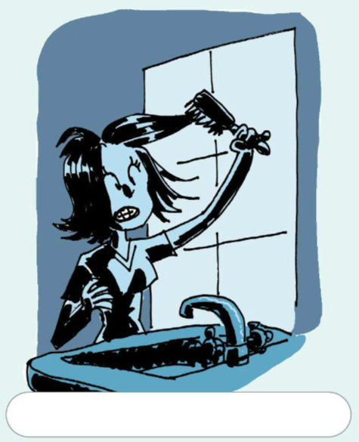
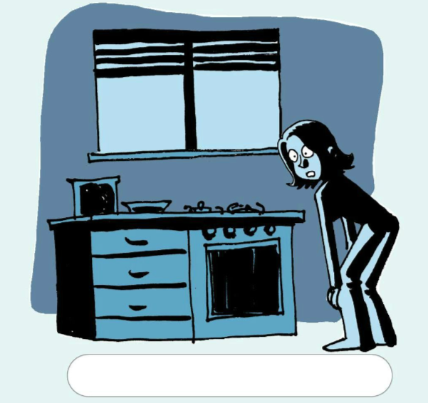
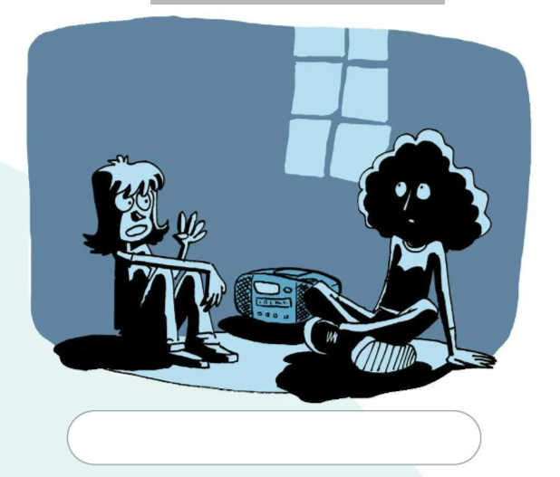
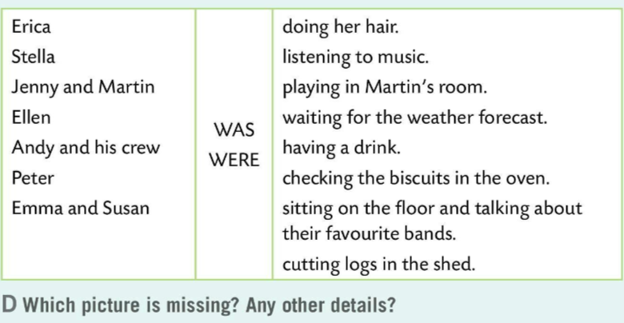
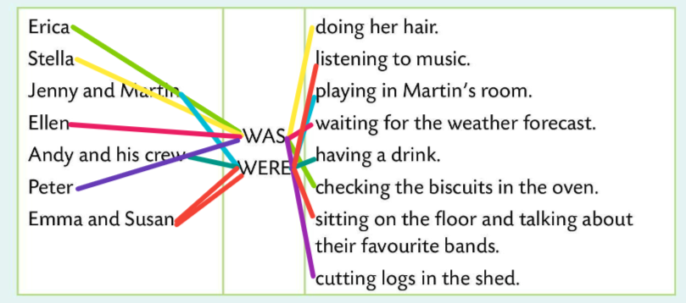
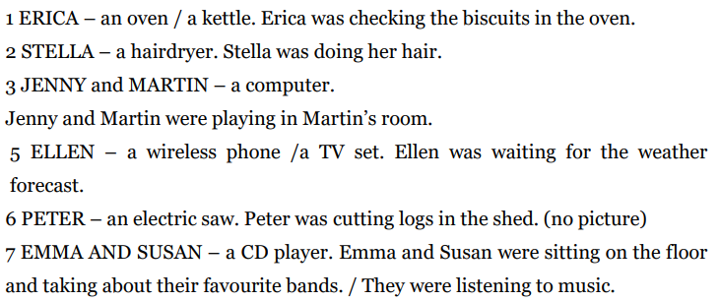




Look at the pictures on pages 114 and 115.
Make sentences using words from Task D. Write the sentences.
Erica – an oven/a kettle
Erica was checking the biscuits in the oven.
Check.
Write down the sentences under the pictures.
Check.

Slide 6
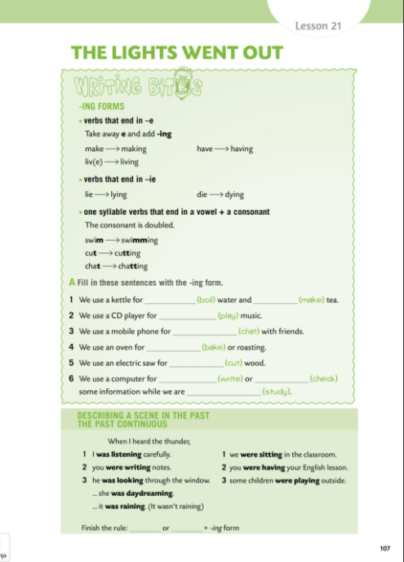

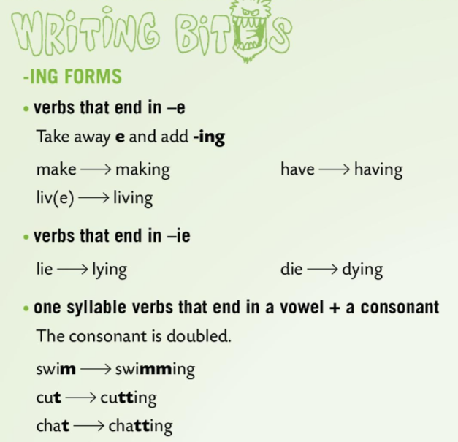
Workbook page 107.
WRITING BITES
Spelling rules:
1 Verbs that end in –e: lose the -e and add –ing. Glagolima koji završavaju na –e uklanjamo nastavak –e i dodajemo nastavak –ing.
make → making have → having
2 Verbs that end in –ie: drop –ie and add -y + –ing.
Kod glagola koji završavaju na nastavak –ie, -ie se gubi i dodaje se –y i nastavak – ing.
lie → lying die→ dying
3 Verbs that have one syllable and end in vowel + a consonant, we double the consonant. Kod jednosložnih glagola koji završavaju na samoglasnik i suglasnik udvostručit ćemo suglasnik i dodati nastavak –ing.
swim→swimming cut→cutting chat→chatting

Slide 7
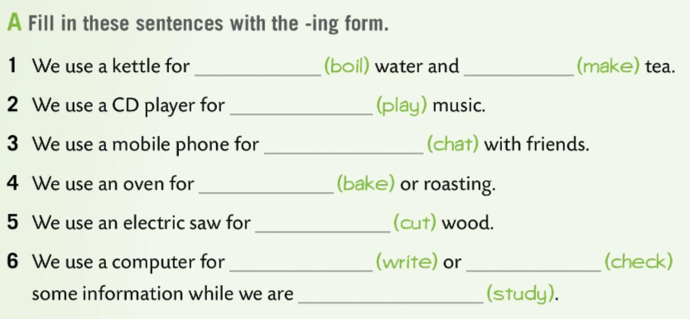
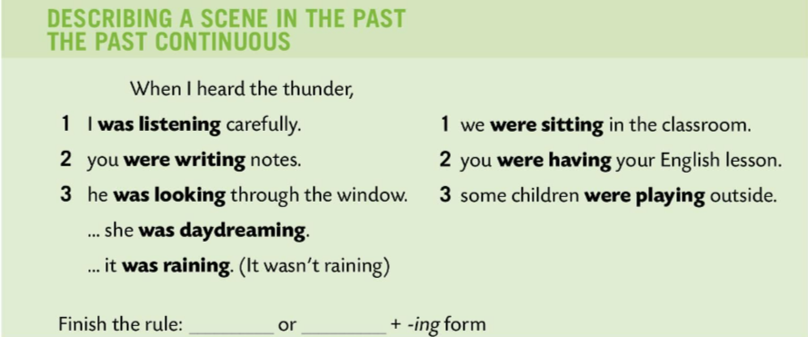
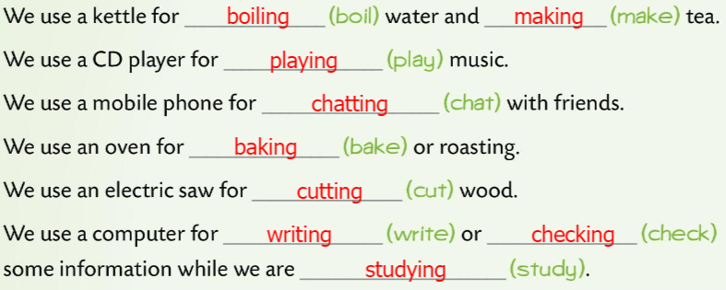
Workbook page 107.
Fill in sentences in Task A with the –ing form. Be careful with your spelling.
Check.
Read the sentences carefully and finish the rule. Write down examples and the rule.
Check.
LANGUAGE IN FOCUS
We use Past Continuous to describe a scene in the past.
subject + WAS/WERE + VERB + -ING
When I heard the thunder, I was reading a book.
Glagolsko vrijeme Past Continuous koristimo za opisivanje prošle radnje.
WAS
WERE

Slide 8
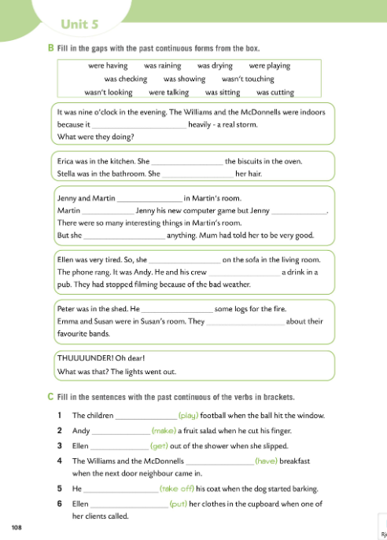
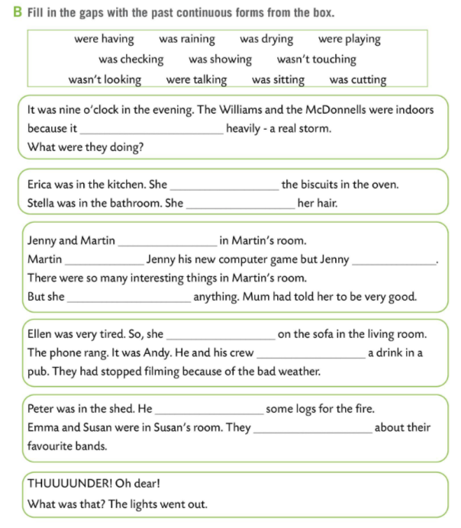
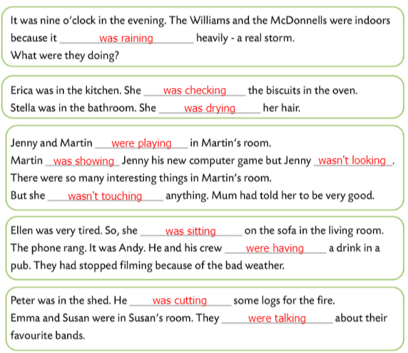
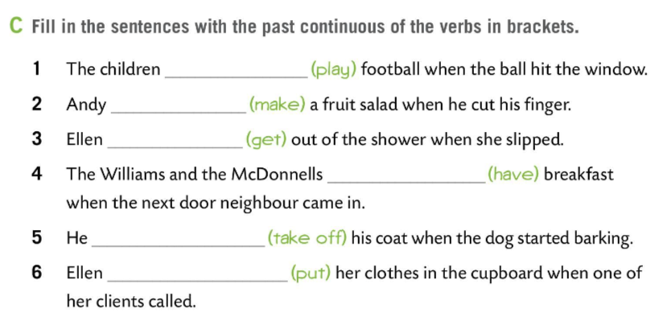
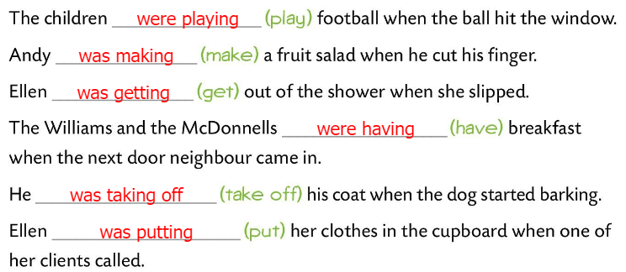
Workbook page 108.
Fill in the gaps in Task B with the Past Continuous forms from the box.
Check.
Fill in the sentences with the past continuous of the verbs in brackets.
Check.

